Slide 1
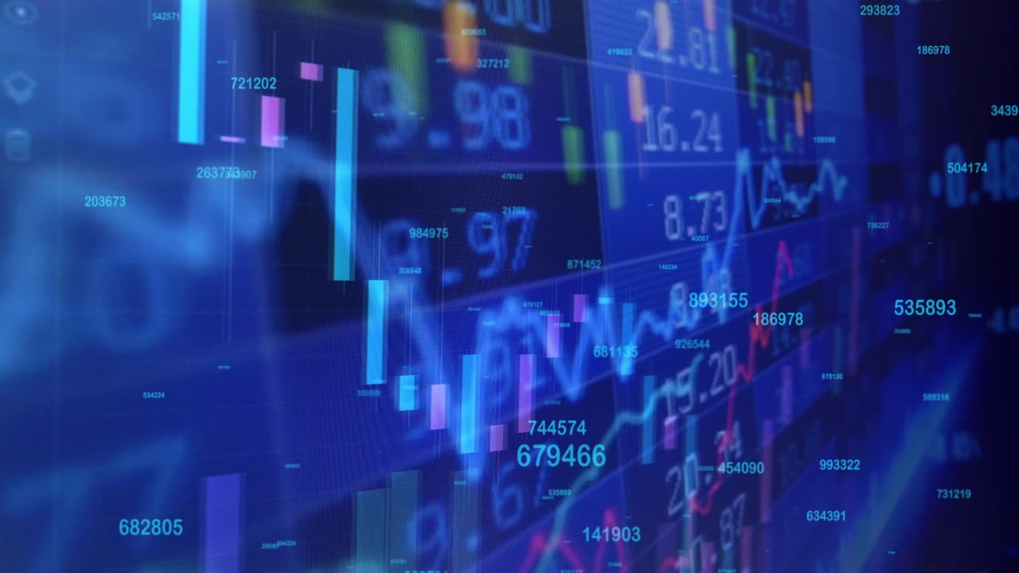
Option Chain Website
by Digital Detectives
Presented By:
Tanisha Admane 16010420001
Yashvi Vora 16010420048
Yash Salunke 16010120043

Slide 2

Introduction
Are you tired of sifting through pages of data to find the information you need? Look no further than an Option Chain Website! With customizable features and real-time data, you'll have everything you need at your fingertips.
The task at hand is to design and implement a robust web application that can handle a continuous market data stream over TCP/IP. The market data stream will contain the following structure:
Underlying Price: Real-time price information for the underlying asset.
Option Contracts: Information on individual option contracts, including strike price, call/put type, bid/ask prices, and open interest.

Slide 3
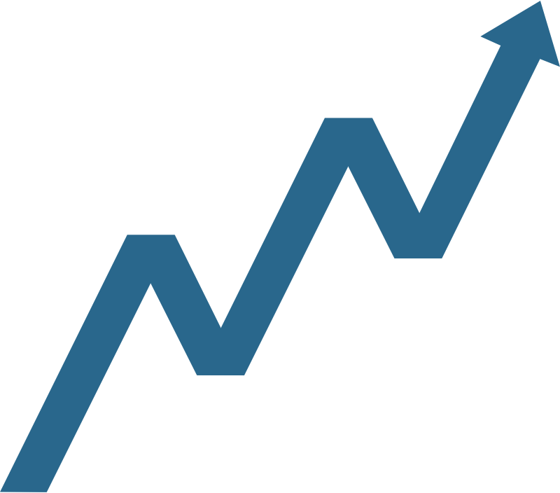
About Option chain
An Option Chain is a list of all available options for a particular stock or index. It displays the different call and put option strike prices and expiration dates which enables traders to quickly and easily see all of their alternatives and select the one that best suits their trading approach.
Key Objectives we've covered in our website:
Efficient Real-Time Processing
Black-Scholes IV Calculation
User-Interface Design

Slide 4

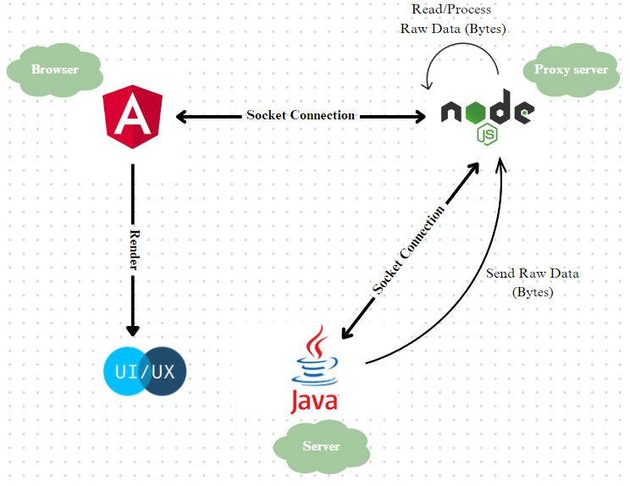
What we have tried to build
In our implementation, we have utilized three key technology stacks: Angular, Java, and Node.js. Angular serves as the frontend framework, while Node.js acts as the backend, with Java functioning as the server. Node.js operates as a proxy server in our architecture.
To establish communication between the Java server and Angular, as well as between Node.js and Java, we have employed socket connections. The Java server transmits raw data in the form of byte streams to Node.js, which handles the reading and processing of this data. Subsequently, Node.js sends the processed data to the user's browser (Angular), where it is rendered and displayed.
By leveraging this implementation, we have achieved an efficient and synchronized flow of data between the server-side components (Java and Node.js) and the client-side application (Angular). This architecture allows for real-time updates and a seamless user experience.

Slide 5
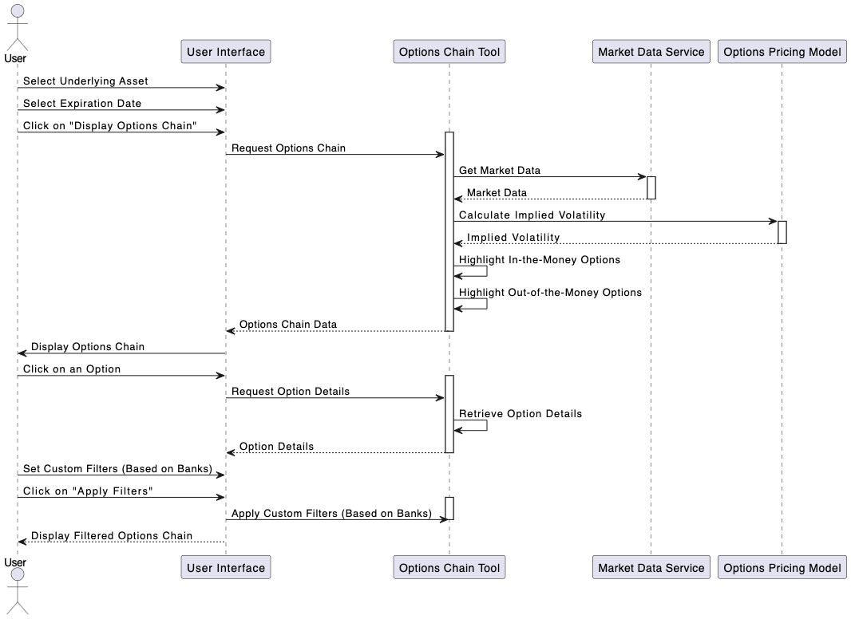
What we have tried to build
Sequence Diagram

Slide 6

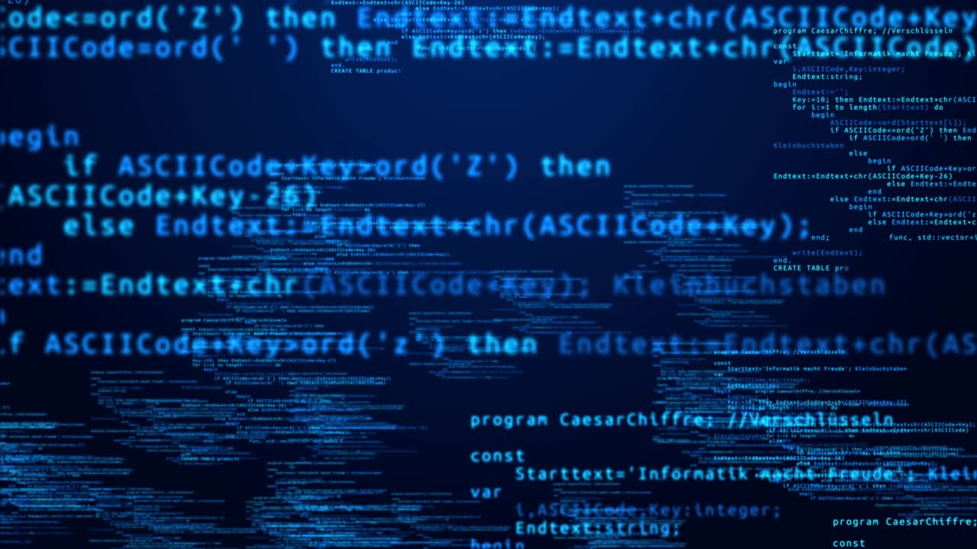
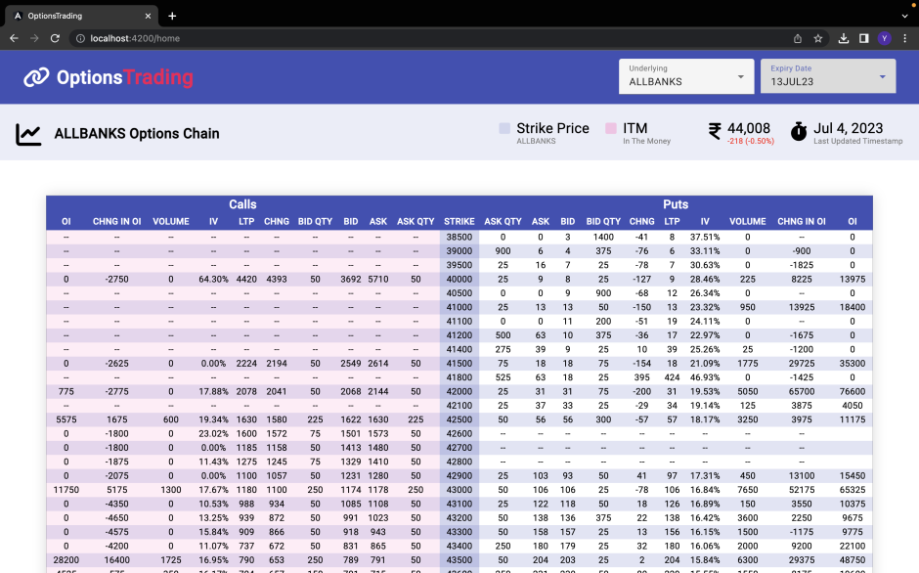
Our Website
Main Page UI
Technologies Used
Front End Development: HTML & CSS
Angular (Socket Programming)
Server: Java
Back End Development: ReactJs

Slide 7

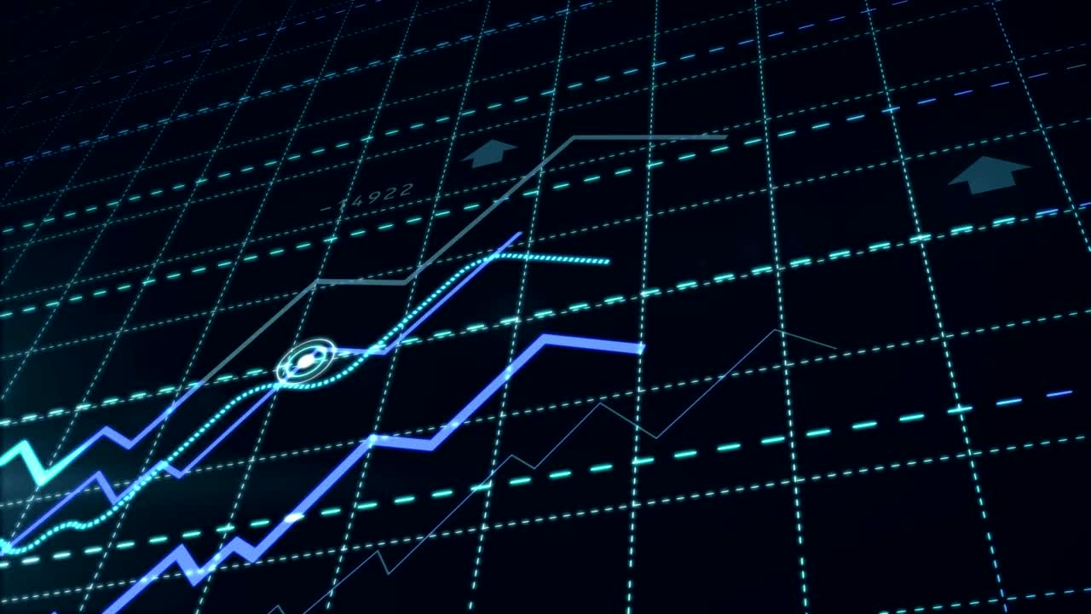
Why should you consider our solution for final round?
Key features we've offered in our website:
Real Time Sharing
In the Money and Out of the Money highlighting
Expiration Date Choice
Customisable Options to choose the required Bank
User friendly interface
Maximum accuracy IV is calculated and provided
Responsive web design
The UI's performance is exceptionally fast, with the table loading almost instantaneously, providing a seamless experience for the user.

Slide 8

Conclusion
In conclusion, our website offers real-time sharing of financial information, with a user-friendly interface and customizable options to choose the required bank. We provide accurate calculations of IV (Implied Volatility) and highlight the status of options as "In the Money" or "Out of the Money" based on their expiration date. The website's responsive design ensures a seamless experience, and the exceptionally fast performance allows for instant loading of tables.
Overall, working on this project during the 3-day hackathon was an interesting experience that provided valuable learning opportunities. We had a great time tackling the problem statement and developing these features.
Thankyou.

Slide 9
This presentation was made on canva for better visual representation follow this link:
https://www.canva.com/design/DAFnmRVeeM8/qWXrg1jwsg52NnsN76YcyQ/edit?utm_content=DAFnmRVeeM8&utm_campaign=designshare&utm_medium=link2&utm_source=sharebutton
THANK YOU

